Slide 1
Country COVID-19 intra-action review (IAR): Presentation template, 28 April 2021 © World Health Organization 2021. Some rights reserved. This work is available under the CC BY-NC-SA 3.0 IGO licence. WHO reference number: WHO/2019-nCoV/Country_IAR/templates/presentation/2021.1

Slide 2
Preamble - Instructions
This presentation is a support for the conduct of a Country COVID-19 Intra-Action Review (IAR). It needs to be adapted to the specific context of the country.
The team lead the IAR will have to complete the yellow sections in this presentation prior to the review.

Slide 3



COVID-19
Country
Dates
INTRA-ACTION REVIEW (IAR)

Slide 4


Slide 5

Adapted from After Action Review guidance
“… implement in-depth reviews of significant disease outbreaks and PH events. (IHR Review Committee Recommendations - Resolution WHA68.5 in May 2015)
Qualitative review of actions taken to respond to an emergency as a means of identifying best practices, gaps and lessons learned
Focuses on functionality
Voluntary
Evaluation of real event – after an event
Involving all those involved in the event to discuss the actions taken in an open and honest environment

Slide 6
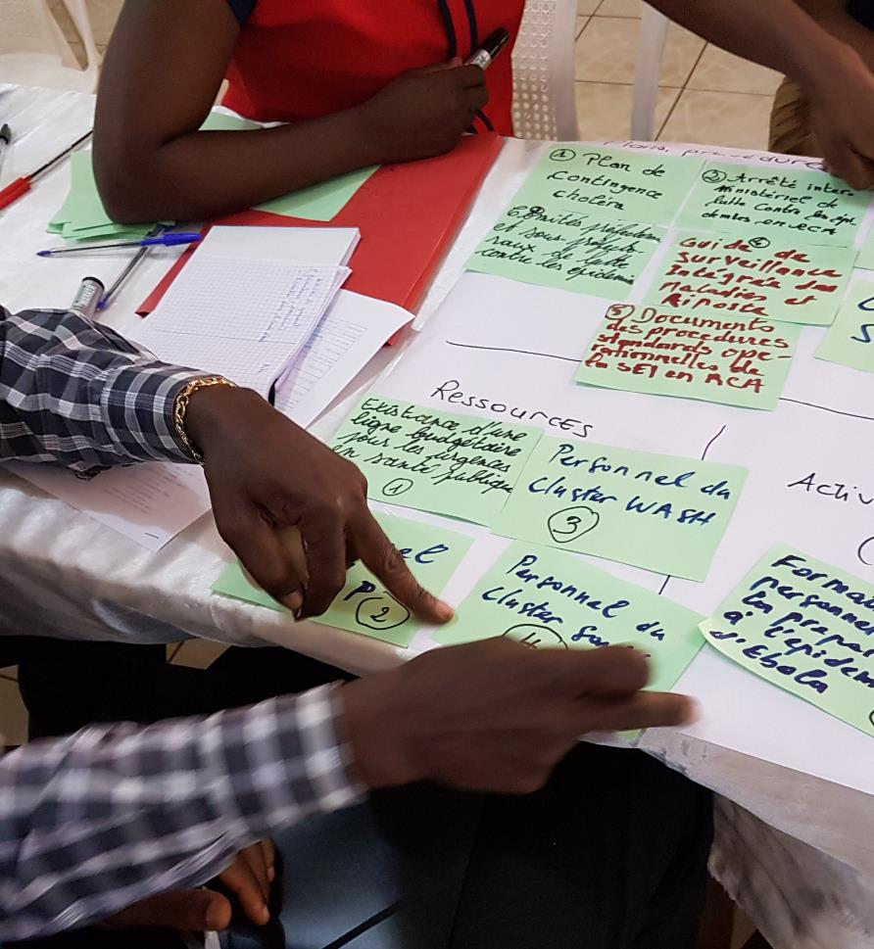
WHAT IS AN INTRA-ACTION REVIEW?
An Intra-Action Review is
a qualitative review of
actions undertaken so far
to respond to an ongoing emergency
as a means of identifying
gaps, lessons and best practices
in order to improve the response plan.

Slide 7
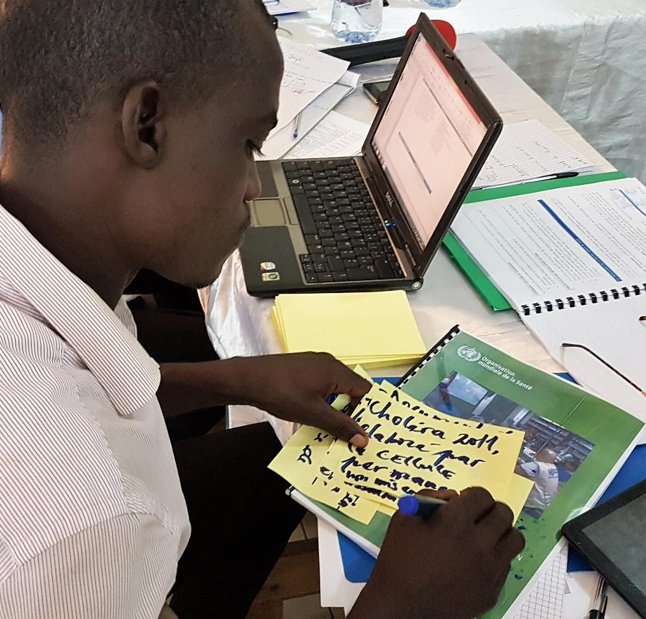
WHAT IS AN INTRA-ACTION REVIEW?
A good practice for continuous collective learning
by bringing together
the relevant stakeholders
to critically and systematically
analyse actions undertaken so far in the response

Slide 8
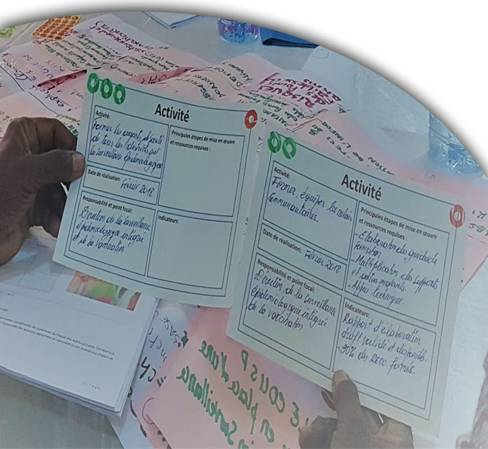
WHAT IS AN INTRA-ACTION REVIEW?
IAR are a constructive, collective learning opportunity,
where stakeholders of an emergency response within the health sector or between sectors,
can find common ground on how to improve preparedness and response capability for the current emergency

Slide 9







Principles
Participative
Open and honest spirit
Space for experience sharing and mutual learning
Analysis of systems and processes
Oriented towards the identification of solutions
A compilation of participants’ perceptions

Slide 10

What an Intra-Action Review is not?
Intra-Action Reviews are not:
an external evaluation of an individual’s or a team’s performance;
an opportunity to criticize, blame or judge individuals.
Intra-Action Reviews do not measure performance against benchmarks or key performance standards.

Slide 11







KEY PHASES CARRIED OUT DURING THE REVIEW
OBJECTIVE OBSERVATION
ANALYSIS OF GAPS & BEST PRACTICES
AND CONTRIBUTING FACTORS
Establish how actions were actually implemented during the response,
in contrast to how they are supposed to or usually happen, according to plans and procedures.
IDENTIFICATION OF AREAS OF IMPROVEMENT
Identify the gap between planning and practice.
Analyse what worked well and what worked less well and why.
Identify actions to strengthen or improve performance
and how to follow-up.

Slide 12


INTRA-ACTION REVIEW OVERVIEW
Introduction: Response plan and actual timeline of the response
STEP 1
Step 1: What went well? What went less well? Why?
STEP 2
Step 2: What can we do to improve the COVID-19 response?
STEP 3
Step 3:The Way Forward

Slide 13
Objectives
Insert the objectives for this review
(objectives can be found in your concept note)

Slide 14
Scope of the COVID-19 Intra-Action Review
List the functions/pillars to be covered
Period covered by this Intra-Action Review

Slide 15
INTRA-ACTION REVIEW OVERVIEW
Introduction: Response plan and actual timeline of the response
STEP 1
Step 1: What went well? What went less well? Why?
STEP 2
Step 2: What can we do to improve the COVID-19 response?
STEP 3
Step 3: The Way Forward

Slide 16
Overview of the response
Presentation of the response by the Ministry of Health
Suggested points to present:
Overview of existing capacities prior to the COVID-19 response
Capacities developed for and during the COVID-19 response
Response strategy
Response timeline during the period under review
Notes:
Be sure to pre load the MOH presentation

Slide 17
INTRA-ACTION REVIEW OVERVIEW
Introduction: Response plan and actual timeline of the response
STEP 1
Step 1: What went well? What went less well? Why?
STEP 2
Step 2: What can we do to improve the COVID-19 response?
STEP 3
Step 3: The Way Forward

Slide 18



INTRA-ACTION REVIEW
STEP 1
Step 1 : What went well? What went less well? Why?
Step 2 : What happened during the response?
STRENGTHS
&
CONTRIBUTING
FACTORS
CHALLENGES
(root cause analysis
see next slide)
of the response
Notes:
Notes:
- See AAR Guide – section 5.1.3 Identification of strengths, challenges and new capacities developed
- Contributing factors = enabling & limiting factors

Slide 19


INTRA-ACTION REVIEW
STEP 1
Step 1 : What went well? What went less well? Why?
Step 2 : What happened during the response?
5 WHY’s
CHALLENGES
STRENGTHS
IMPACTS
IMPACTS
CAUSES
CAUSES
CAUSES
CAUSES
CAUSES
CAUSES
LIMITING & ENABLING
FACTORS
Notes:
AAR Guide - Box 5.2.4. Root cause analysis
Root cause analysis is a method used to identify the factors that led or contributed to success or failure in relation to a specific issue or problem identified. The root cause is a factor that leads directly to a particular outcome (good or bad). The removal of this factor will prevent the outcome from occurring. The purpose of conducting such analysis during an AAR is to identify and eventually address the root cause, if necessary, in order to prevent a negative outcome. The purpose of the analysis is to focus the interventions on those that have a long-term impact rather than relying on quick fixes.
Root cause analysis should be used when a problem is identified that clearly requires deeper examination, or for which the why of a challenges is not answered.
The “5 Whys method” is the simplest and most frequently used approach to root cause analysis. In essence, the facilitator repeatedly asks “Why?”, to progressively unpack causative factors and thus get to the root cause of a particular issue. This technique is the most appropriate in the frame of an AAR group discussion.
Use the actions described above to elaborate clear activities, responsible focal point, resources needed, and timeline for implementation.
Add a conversation between the facilitator and participant:
Participant: One of the biggest issues was that we weren’t getting the samples back from the labs fast enough
Facilitator: Why did that happen
Participant: Well we weren’t to arrange transport to and from the labs
Facilitator: Why was that, did you have no vehicles?
Participant: Yes we had vehicles available
Facilitator: so why couldn’t you use them for transporting
Participant: We could, but they had not fuel
Facilitator: Why was that?
Participant: Funds weren’t made available as the petty cash limit was too low

Slide 20
INTRA-ACTION REVIEW
STEP 1
Step 1 : What went well? What went less well? Why?
Using the trigger questions, identify the challenges and best practices during the response
For each challenge and best practice, identify the impact this has had on the response during the period under review
For each challenge and best practice, identify limiting factors (for challenges) and enabling factors (for best practices)
Identify no more than 6 key challenges and 6 key best practices

Slide 21

INTRA-ACTION REVIEW
STEP 1
Step 1 : What went well? What went less well? Why?
Best Practices/Strengths | Impact(s) | Enabling factors
Improved coordination and sharing of information for the early detection of suspected/ confirmed cases and for monitoring contacts
Relationship had been established prior to the response
Willingness of all stakeholders to undertake regular meetings
Political and financial support from central level
Regular cross-border coordination meetings
Challenges | Impact(s) | Limiting Factors
Response not coordinated between partners, health authorities and the central level
Duplication of activities and effort
Lack of a plan for district level coordination
Partners not participating in coordination meetings
Coordination at local level ineffective

Slide 22
INTRA-ACTION REVIEW
STEP 1
Step 1 : What went well? What went less well? Why?
Important definitions
Best practice:
Something that was done during the COVID-19 response that improved performance or had a positive impact.
Examples:
Development of new SOPs for COVID-19 diagnosis.
Organization of cross-border meetings during the COVID-19 response to facilitate better coordination.

Slide 23
INTRA-ACTION REVIEW
STEP 1
Step 1 : What went well? What went less well? Why?
Important definitions
Challenge:
Job, duty or situation that is difficult during the COVID-19 response because you must use a lot of effort, determination, and skill in order to be successful.
Examples:
Lack of coordinated communication between MoH and partners.
Limited capacity for COVID-19 testing at subnational level.

Slide 24

INTRA-ACTION REVIEW
STEP 1
Step 1 : What went well? What went less well? Why?
Remember the objective is:
To identify the best practices and the key challenges
but also
To identify and institutionalize
new capacities
Developed so far during the response
e.g. new SOP, new equipment purchased, new skills learned…etc.
NEW

Slide 25
INTRA-ACTION REVIEW OVERVIEW
Introduction: Response plan and actual timeline of the response
STEP 1
Step 1: What went well? What went less well? Why?
STEP 2
Step 2: What can we do to improve the COVID-19 response?
STEP 3
Step 3: The Way Forward

Slide 26
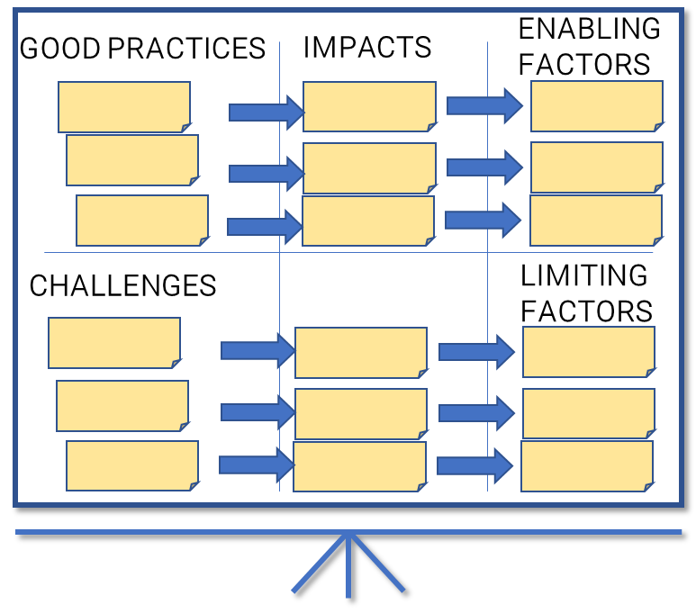

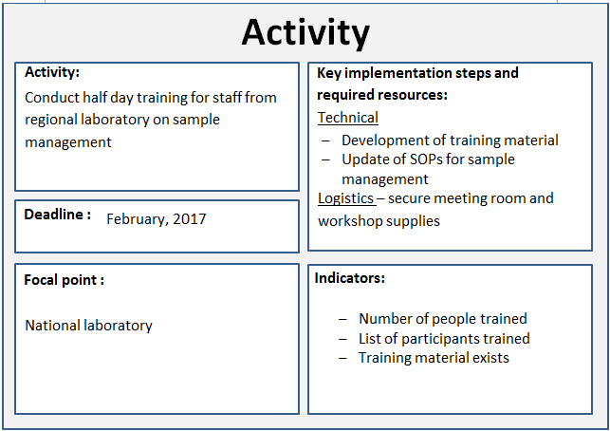
INTRA-ACTION REVIEW
STEP 2
Step 2 : What can we do to improve the COVID-19 response?
Institutionalize best practices
Address challenges
Development of specific activities:
to build on enabling factors
to address the limiting factors

Slide 27
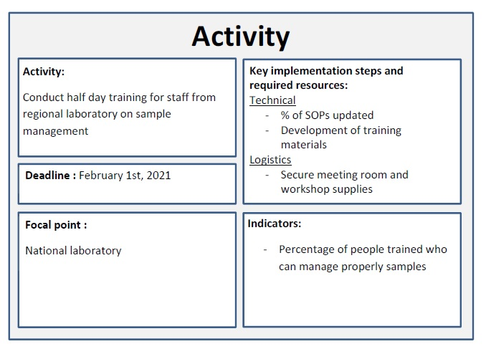
INTRA-ACTION REVIEW
STEP 2
Step 2 : What can we do to improve the COVID-19 response?
All activities need to be practical and realistic
Several activities might be necessary to address a single challenge or a best practice
Not all best practices or challenges need an activity

Slide 28
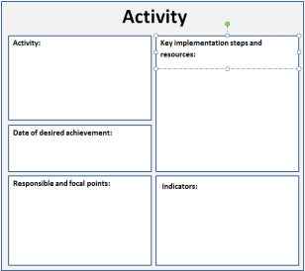
INTRA-ACTION REVIEW
STEP 2
Step 2 : What can we do to improve the COVID-19 response?
Refer to the challenges, best practice, impact and factors to help identify key activities to overcome challenges and institutionalize best practices.

Slide 29
INTRA-ACTION REVIEW OVERVIEW
Introduction: Response plan and actual timeline of the response
STEP 1
Step 1: What went well? What went less well? Why?
STEP 2
Step 2: What can we do to improve the COVID-19 response?
STEP 3
Step 3: The Way Forward

Slide 30
INTRA-ACTION REVIEW
STEP 3
Step 3 : The Way Forward
In the plenary session, discuss and agree on the following:
Identification of:
what can be addressed immediately to improve the ongoing response;
what can be done in the mid and long-term to improve response to the next waves of the COVID-19 outbreak.
Establishment of an Intra-Action Review Follow-up team
Process to document progress in implementing the recommendations
Approach to ensure engagement of senior leadership

Slide 31

INTRA-ACTION REVIEW
Thank for your contribution to saving lives!

